Slide 1


ADMIS Lab
先进数据与机器智能系统实验室
Physical Storage Systems & Data
Storage Structures
Chapters 12 & 13
Yichao Zhang
Email: yichaozhang@tongji.edu.cn
Department of Computer Science and Technology
Tongji University

Slide 2
Outline
Overview of Physical Storage Media
Magnetic Disks
RAID
Tertiary Storage
Storage Access
File Organization
Organization of Records in Files
Data-Dictionary Storage

Slide 3
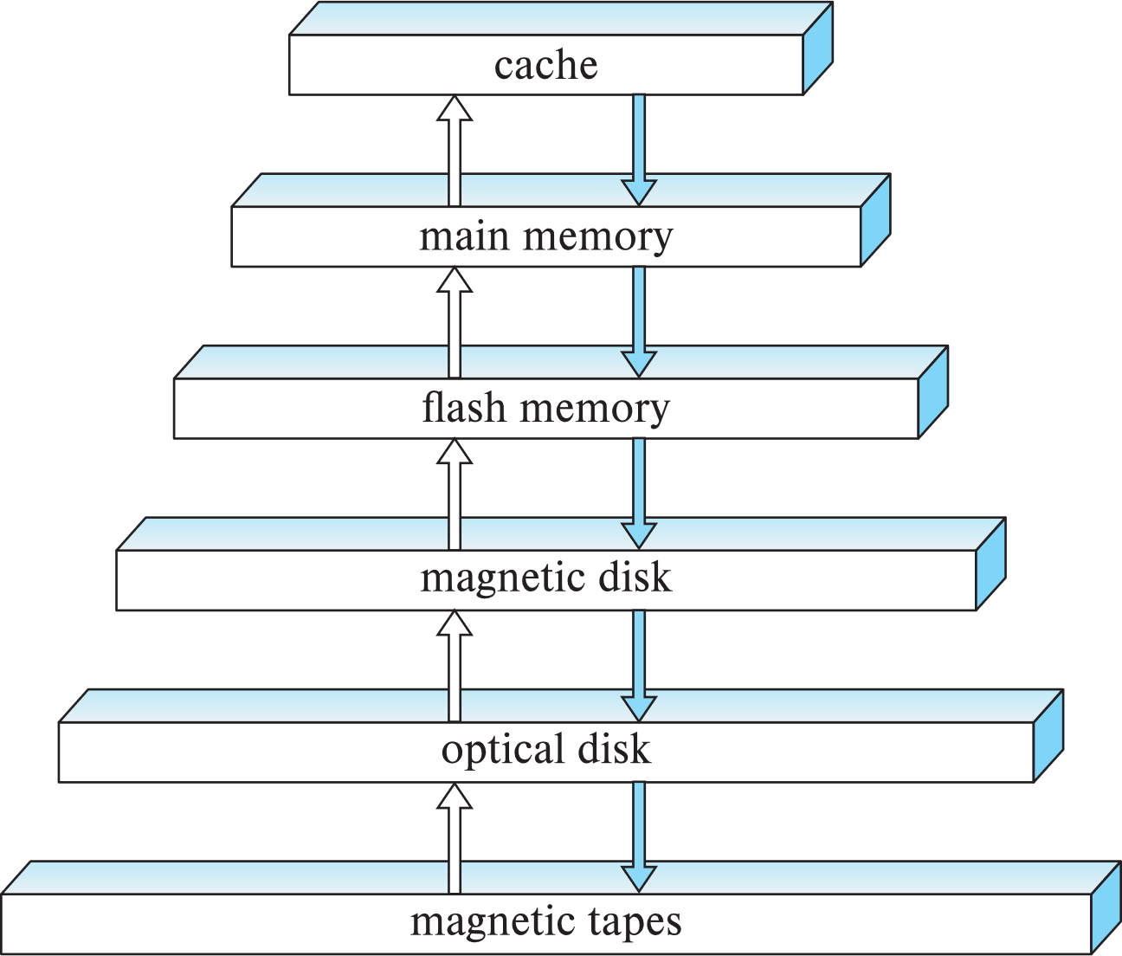
Storage Hierarchy
primary storage
volatile
secondary storage/
non-volatile
tertiary storage/
non-volatile
Notes:
Optical disk 光盘
tertiary storage：三级存储
Volatile：易变的

Slide 4
Classification of Physical Storage Media
Speed
  the speed with which data can be accessed
Cost
  the cost for storing each unit of data
Reliability
  volatile storage (易失性存储）: lose contents when power is switched off
  non-volatile storage (非易失性存储）: contents persist when power is switched off
    Secondary (第二级) and tertiary（第三级）storage
    battery-backed up main-memory

Slide 5
Cache & Main Memory
Cache (缓存)
  the fastest and most costly form of storage
  volatile
Main memory (主存/内存)
  fast access (about 100 nanoseconds, 1 nanosecond = 10^{–9} seconds)
  generally too small (or too expensive) to store the entire database
    capacities of up to a few Gigabytes widely used currently
    capacities have gone up and per-byte cost has decreased steadily
  volatile — contents of main memory will be lost if a power failure or system crash occurs

Slide 6
Flash Memory
Flash memory (闪存)
  Data survives power failure
  Data can be written at a location only once, but the location can be erased and written again
    support 10K – 1M write/erase cycles
  Reads are roughly as fast as main memory, but writes are slow (few microseconds)
  Cost per unit of storage is similar to main memory
  Widely used in embedded devices such as digital cameras
  USB, SSD

Slide 7
Magnetic Disk
Magnetic disk (磁盘)
  Primary medium for the long-term storage of data
    Typically stores the entire database
  Data must be moved from disk to main memory for access, and written back for storage
    Much slower access than main memory
  Capacities range up to several TBs currently
    Much larger capacity and lower cost/byte than main memory/flash memory
    Growing constantly and rapidly with technology improvements
  Survives power failures and system crashes
    disk failure can destroy data, but is rare

Slide 8
Optical Storage
Optical storage (光学存储器)
  Non-volatile, data is read optically from a spinning disk using a laser
  CD-ROM (640 MB) and DVD (4.7 to 17 GB) are the most popular forms
  Write-one, read-many (WORM) optical disks used for archival storage
    CD-R, DVD-R, DVD+R
  Multiple write versions also available
    CD-RW, DVD-RW, DVD+RW, DVD-RAM
  Reads and writes are slower than magnetic disk

Slide 9
Optical Storage (续)
Optical storage (光学存储器)
  2010年5月，日本东京大学化学教授大越慎一(Shin-ichi Ohkoshi)研究团队发现一种材料，可以用来制造更便宜的大容量超级光盘，可储存容量是目前一般DVD的5千倍
  材料是一种透明的新型氧化钛，平常是能导电的黑色金属状态，在受到光的点击后会转变成棕色的半导体。在室温下受到光的照射，能够任意在金属和半导体之间转变，因而产生储存数据功能。这种材料所制成的新光碟，容量是蓝光光盘的1千倍，而蓝光光盘的容量则是一般DVD的5倍。一般一张DVD为4.7G，一张蓝光光盘为25G。最新的蓝光协会表示，新蓝光光盘容量可达128G。东京大学的最新光盘容量将达25000G，即25T
  2012年富士胶片开发利用双光子吸收热量的新型光盘记录方式，可实现每层25GB的记录密度，与蓝光光盘相同，且该技术有可能实现多达20层的多层化。富士新技术单张盘片容量可达15TB

Slide 10
Tape Storage
Tape storage (磁带存储器)
  Non-volatile, used primarily for backup (to recover from disk failure), and for archival data
    IBM、EMC、Dell…
  Sequential-access – much slower than disk
  Very high capacity (40 to 300 GB tapes available)
  Can be removed from drive
  Storage cost is much cheaper than disk, but the drive is expensive

Slide 11
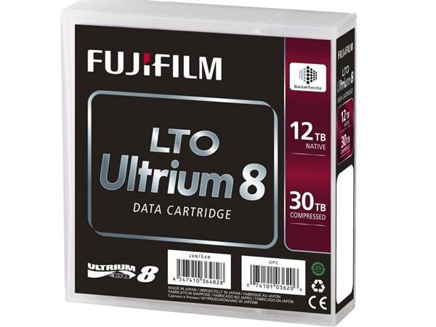

Tape Storage（续）
磁带是一种古老的存储数据方式，随着人类数据量爆炸式增长，磁带设备焕发新生，IBM大中华区CTO谢东近日提出，磁带在未来十年仍将是主流存储媒介，其容量将会每年增长30％，而传统硬盘增幅只有10％。人类需要保存的很多数据都是冷数据，是不常用的数据，大部分是为了备份、保存，需求量还在不断增长，而磁带的优势就正是存储容量超大、成本低廉、保存时间长等。
富士LTO系列磁带，Ultrium 8系列磁带采用BaFe（钡铁氧体磁性材料），并有富士专利的纳米超薄涂层技术，磁带长度960m，宽度12.65mm，厚度5.6um。LTO Ultrium 8系列磁带容量高达30TB（未压缩时是12TB），是前代产品的两倍，而且速度可达750MB/s（未压缩时是360MB/s），性能及容量都要比HDD硬盘要有优势，适合长期保存重要数据。
LTO 8系列磁带有两种类型，一种是可以重复擦写数据的，另外一种是WROM，写入一次，多次读取类型的，这种类型的可以防止数据被篡改或者意外删除，提高了安全性。

Slide 12
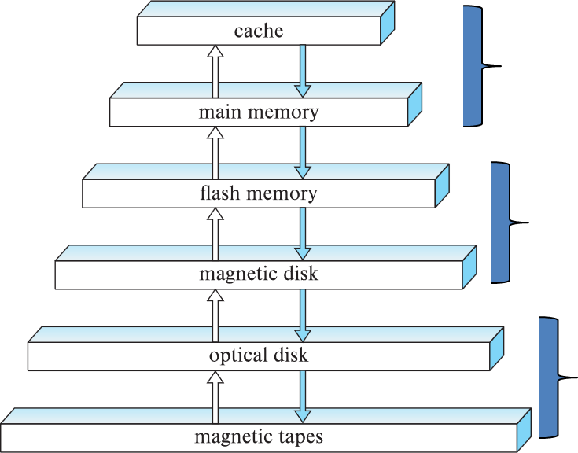
Storage Hierarchy
Primary storage
  Fastest media but volatile (cache, main memory)
Secondary storage
  Non-volatile, moderately fast access time
  Also called on-line storage, e.g., flash memory, magnetic disks
Tertiary storage
  Non-volatile, slow access time
  Also called off-line storage, e.g., magnetic tape, optical storage

Slide 13
Outline
Overview of Physical Storage Media
Magnetic Disks
RAID
Tertiary Storage
Storage Access
File Organization
Organization of Records in Files
Data-Dictionary Storage

Slide 14
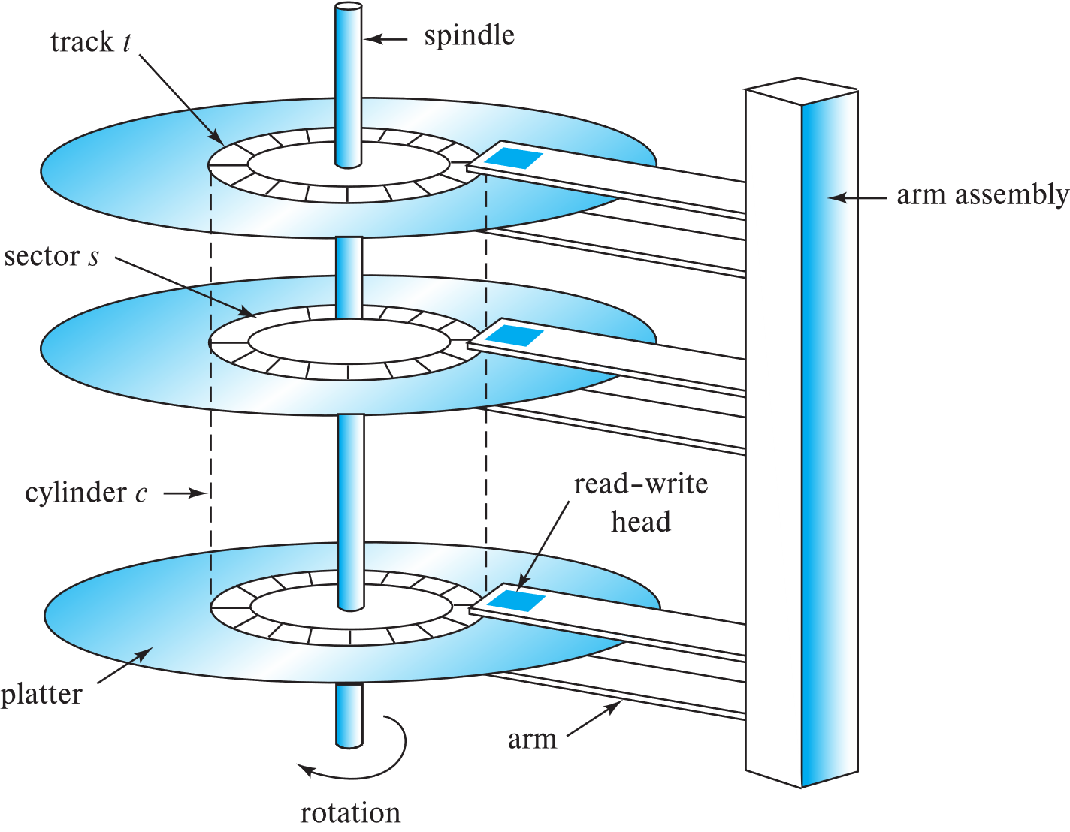
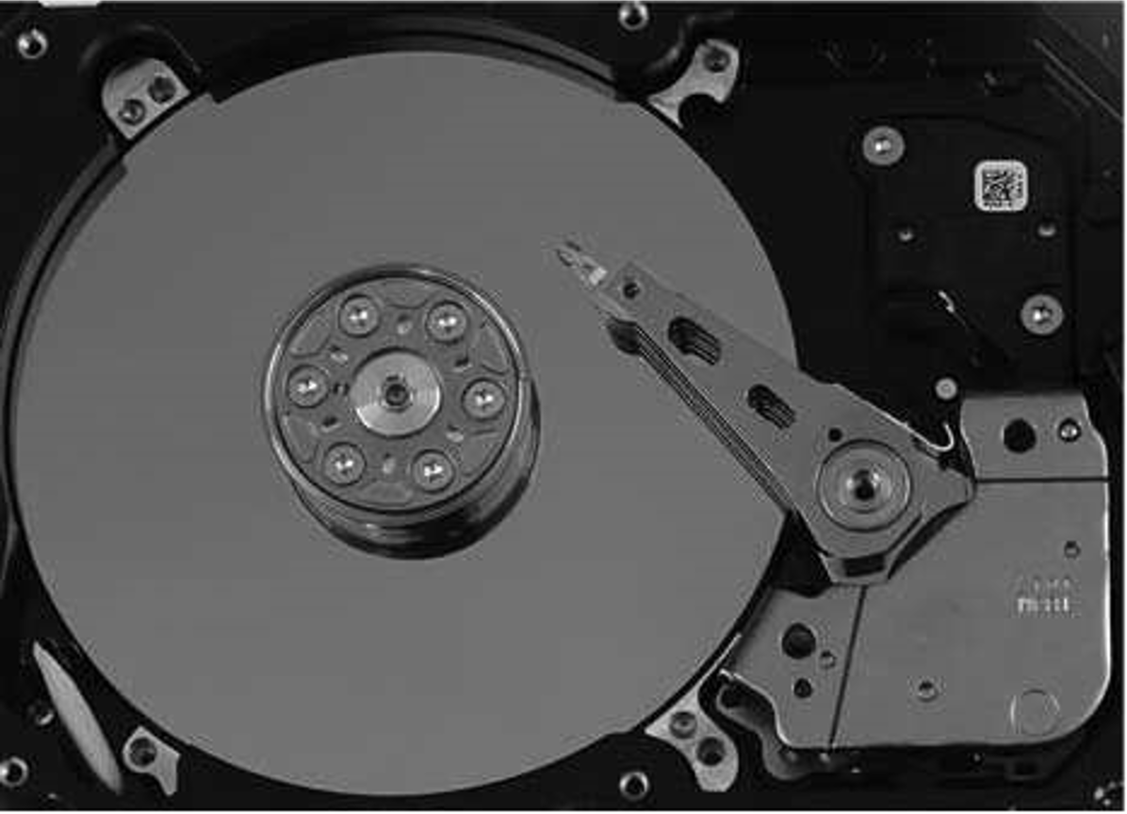
Magnetic Hard Disk Mechanism
spindle: 主轴
arm assembly: 磁盘臂组件
arm: 磁盘臂
cylinder: 柱面
platter: 盘片
track: 磁道
sector: 扇区
read-write head: 读写头
Schematic diagram of magnetic disk drive
Photo of magnetic disk drive

Slide 15
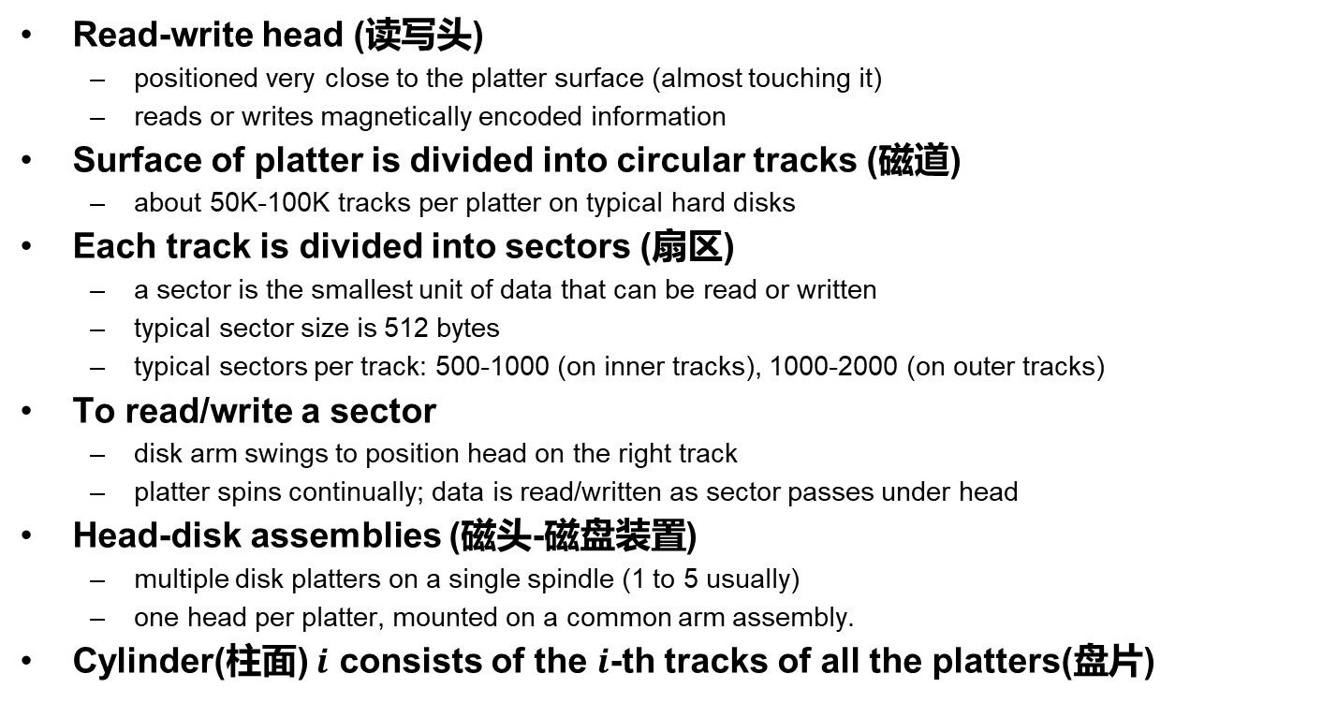
Magnetic Disks
Read-write head (读写头)
  positioned very close to the platter surface (almost touching it)
  reads or writes magnetically encoded information
Surface of platter is divided into circular tracks (磁道)
  about 50K-100K tracks per platter on typical hard disks
Each track is divided into sectors (扇区)
  a sector is the smallest unit of data that can be read or written
  typical sector size is 512 bytes
  typical sectors per track: 500-1000 (on inner tracks), 1000-2000 (on outer tracks)
To read/write a sector
  disk arm swings to position head on the right track
  platter spins continually; data is read/written as sector passes under head
Head-disk assemblies (磁头-磁盘装置)
  multiple disk platters on a single spindle (1 to 5 usually)
  one head per platter, mounted on a common arm assembly.
Cylinder(柱面) $i$ consists of the $i$-th tracks of all the platters(盘片)
Notes:
Spindle：轴

Slide 16
Magnetic Disks (Cont.)
Earlier generation disks were susceptible to head-crashes
  Surface of earlier generation disks had metal-oxide coatings (金属氧化物涂层) which would disintegrate on head crash and damage all data on disk
  Current disks are less susceptible to such disastrous failures
Disk controller(磁盘控制器) – interfaces between the computer system and the disk drive hardware
  Accept high-level commands to read or write a sector
  Initiate actions such as moving the disk arm to the right track and actually reading or writing the data
  Compute and attach checksums(校验和) to each sector to verify that data is read back correctly.
  Performs remapping of bad sectors(坏扇区重映射)
Notes:
Disintegrate：分解

Slide 17
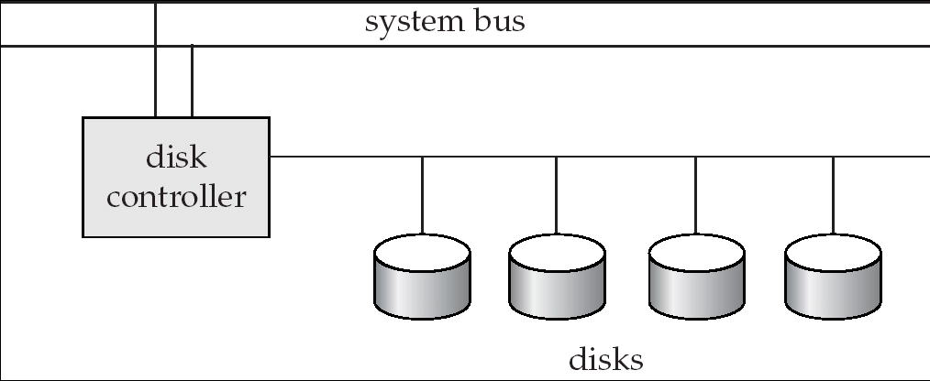
Disk Subsystem
Multiple disks connected to a computer system through a controller
  Controller functionality (checksum, bad sector remapping) is often carried out by individual disks to reduce the load on controller
Disk interface standards families
  ATA (AT adaptor/attachment) range of standards (1994-2002,7 standards)
  SATA (Serial ATA)、PATA (Parallel ATA)
  SCSI (Small Computer System Interconnect) range of standards
  Several variants of each standard (different speeds and capabilities)
Notes:
自20世纪80年代，ATA是一种存储设备连接标准

Slide 18
Performance Measures of Disks
Access time(访问时间)
  the time it takes from when a read or write request is issued to when data transfer begins, including
    Seek time(寻道时间) – the time it takes to reposition the arm over the correct track.
      average seek time is about 1/2 the worst case seek time
      4 to 10 milliseconds on typical disks
    Rotational latency(旋转等待) – time it takes for the sector to be accessed to appear under the head
      average latency is 1/2 of the worst case latency.
      4 to 11 milliseconds on typical disks (5400 to 15000 rpm)
Notes:
milliseconds：毫秒

Slide 19
Performance Measures (Cont.)
Data-transfer rate(数据传输率)
  the rate at which data can be retrieved from or stored to the disk
  Max rate: 25 to 100 MB per second, lower for inner tracks
  Multiple disks may share a controller, so the rate that controller can handle is also important
    E.g., ATA-5: 66 MB/sec, SATA: 150 MB/sec, Ultra 320 SCSI: 320 MB/s
    Fiber Channel (FC2Gb): 256 MB/s

Slide 20
Performance Measures (Cont.)
Mean time to failure (平均故障时间, MTTF)
  The average time the disk is expected to run continuously without any failure
  Probability of failure of new disks is quite low, corresponding to a “theoretical MTTF” of 500,000 to 1,200,000 hours for a new disk
    E.g., an MTTF of 1,200,000 hours for a new disk means that given 1000 new disks, one will fail every 1200 hours on the average
  MTTF decreases as disk ages

Slide 21
Optimization of Disk-block Access
Block – a contiguous sequence of sectors from a single track
  data is transferred between disk and main memory in blocks
  sizes range from 512 bytes to several kilobytes
    small blocks: more transfers from disk
    large blocks: more space wasted due to partially filled blocks
    typical block sizes range from 4 to 16 kilobytes
Disk-arm-scheduling(磁盘臂调度) algorithms order pending accesses to tracks so that disk arm movement is minimized
  elevator algorithm(电梯算法) : move disk arm in one direction (from outer to inner tracks or vice versa), processing next request in that direction, till no more requests in that direction, then reverse direction and repeat

Slide 22
Optimization of Disk Block Access (续)
File organization – optimize block access time by organizing the blocks according to the way of data access
  E.g., store related information on the same or nearby cylinders
  Files may get fragmented(碎片化) over time
    data is inserted to/deleted from the file
    free blocks on disk are scattered, and newly created file has its blocks scattered over the disk
    sequential access to a fragmented file results in increased disk arm movement
  Some systems have utilities to defragment the file system, in order to speed up file access

Slide 23
Optimization of Disk Block Access (Cont.)
Non-volatile write buffers speed up disk writes by writing blocks to a non-volatile RAM buffer immediately
  Non-volatile RAM: battery backed up RAM or flash memory
    Even if power fails, the data is safe and will be written to disk when power returns
  Controller writes to disk when the disk has no other requests or the non-volatile RAM is full
  Database operations can continue without waiting for data to be written to disk
  Writes can be reordered to minimize disk arm movement

Slide 24
Optimization of Disk Block Access (Cont.)
Log disk(日志磁盘)
  a disk devoted to writing a sequential log of block updates
  used exactly like nonvolatile RAM
    write to log disk is very fast since seeking is not required
    no need for special hardware (NV-RAM)
File systems typically reorder writes to disk to improve performance
  Journaling file systems(日志文件系统) write data in safe order to NV-RAM or log disk
  Reordering without journaling: risk of corruption of file system data

Slide 25
Outline
Overview of Physical Storage Media
Magnetic Disks
RAID
Tertiary Storage
Storage Access
File Organization
Organization of Records in Files
Data-Dictionary Storage

Slide 26
RAID (独立冗余磁盘阵列)
RAID: Redundant Arrays of Independent Disks
  Disk organization techniques that manage a large numbers of disks, providing a view of a single disk of
    High capacity and high speed by using multiple disks in parallel
    High reliability by storing data redundantly. Data can be recovered even if a disk fails

Slide 27
RAID (Cont.)
The chance that some disk out of a set of N disks will fail is much higher than the chance that a specific single disk will fail
  E.g., a system with 100 disks, each with MTTF of 100,000 hours (approx. 11 years), will have a system MTTF of 1000 hours (around 41 days)
  Techniques for using redundancy to avoid data loss are critical with large numbers of disks
Originally a cost-effective alternative to large, expensive disks
  I in RAID originally stood for “inexpensive”
  Now the “I” is interpreted as independent
Notes:
cost-effective:划算的

Slide 28
Improvement of Reliability via Redundancy
Redundancy – store extra information that can be used to rebuild information lost in a disk failure
  Mirroring (镜像): Duplicate every disk, and each logical disk consists of two physical disks
  Every write is carried out on both disks
    Reads can take place from either disk
  If one disk in a pair fails, data still available in the other
    Data loss would occur only if a disk fails, and its mirror disk also fails before the system is repaired
    Probability of combined event is very small except for dependent failure modes such as fire or building collapse or electrical power surges
Mean time to data loss (平均数据丢失时间) depends on mean time to failure (平均故障时间) and mean time to repair (平均修复时间)
Notes:
electrical power surges：电涌
Mean time to data loss = mean time to failure^2/(2*mean time to repair)

Slide 29
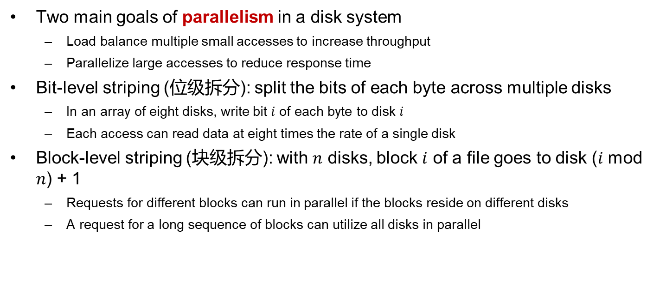
Improvement in Performance via Parallelism
Two main goals of parallelism in a disk system
  Load balance multiple small accesses to increase throughput
  Parallelize large accesses to reduce response time
Bit-level striping (位级拆分): split the bits of each byte across multiple disks
  In an array of eight disks, write bit $i$ of each byte to disk $i$
  Each access can read data at eight times the rate of a single disk
Block-level striping (块级拆分): with $n$ disks, block $i$ of a file goes to disk ($i$ mod $n$) + 1
  Requests for different blocks can run in parallel if the blocks reside on different disks
  A request for a long sequence of blocks can utilize all disks in parallel
Notes:
striping：数据拆分

Slide 30
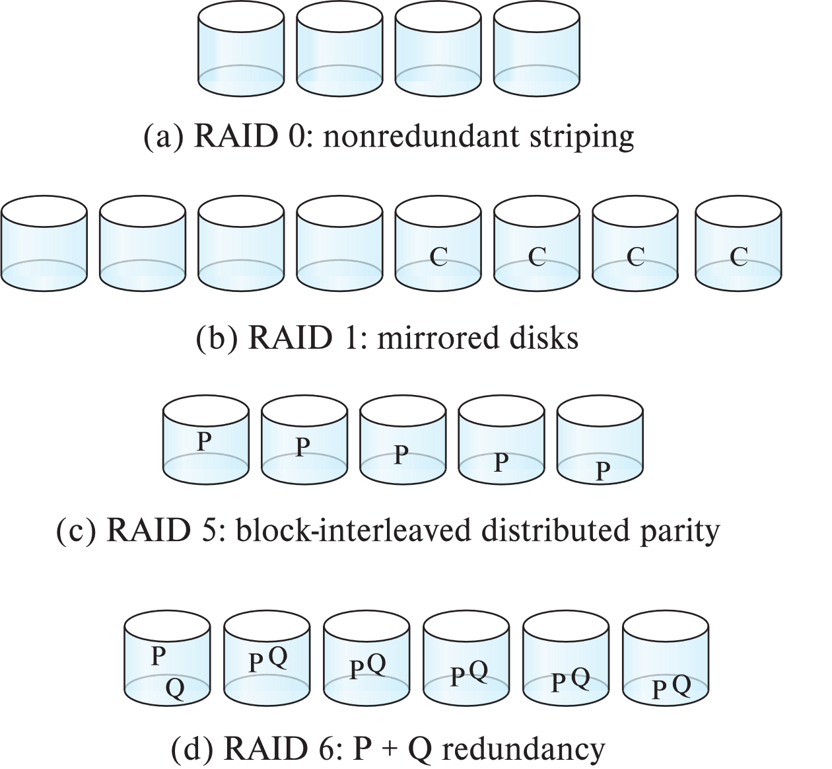
RAID Levels
Schemes to provide redundancy at lower cost by using disk striping (磁盘拆分) combined with parity bits(奇偶校验位)
  Different RAID organizations, or RAID levels, have differing cost, performance and reliability characteristics
RAID Level 0: Block striping, non-redundant. (无冗余拆分)
  Used in high-performance applications where data lose is not critical
RAID Level 1: Mirrored disks with block striping (镜像磁盘)
  Offers best write performance.
  Popular for applications such as storing log files in a database system

Slide 31
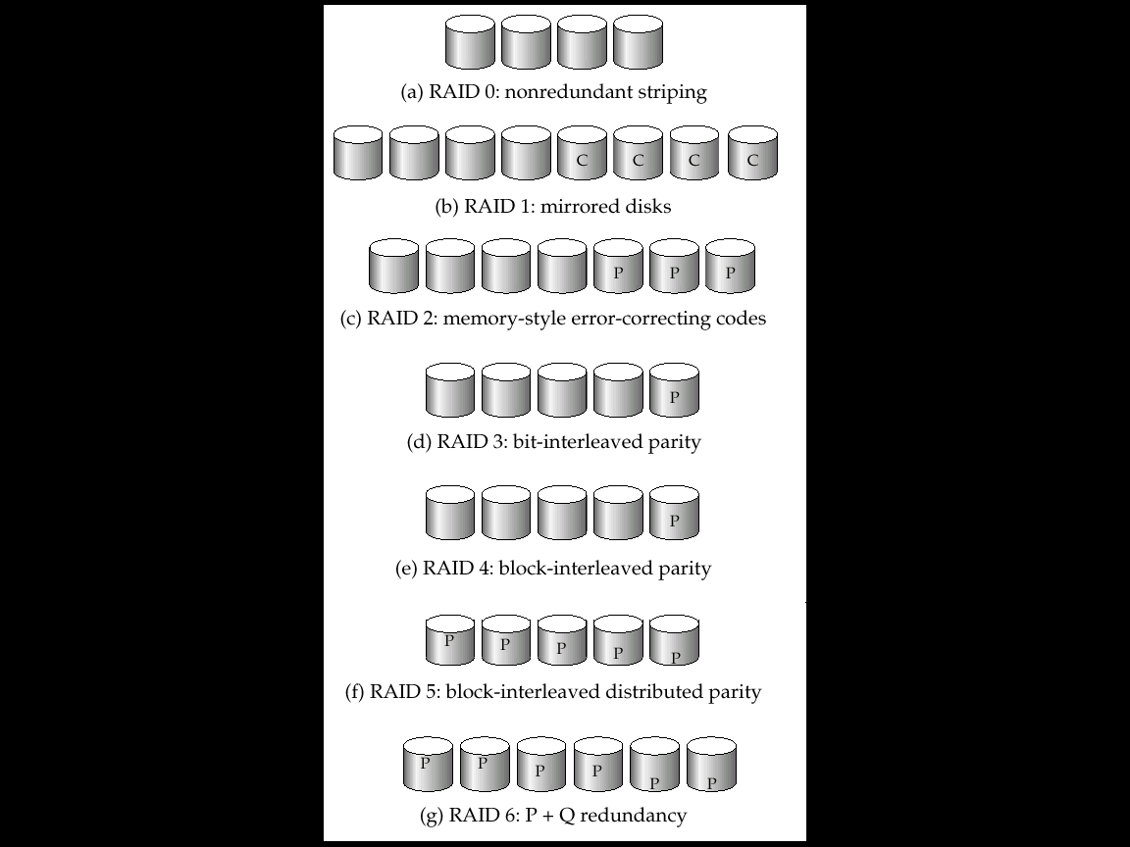
RAID Levels (Cont.)
RAID Level 2: Memory-Style Error-Correcting-Codes (ECC) with bit striping. (内存风格的纠错码, 奇偶校验位)
RAID Level 3: Bit-Interleaved Parity (位交叉的奇偶校验)
  a single parity bit is enough for error correction, not just detection, since we know which disk has failed
    When writing data, corresponding parity bits must also be computed and written to a parity bit disk
    To recover data in a damaged disk, compute XOR of bits from other disks (including parity bit disk)
Notes:
parity bit：奇偶校验位
内存检验：
一个字节中存储了某一数值（1、0、0、1、1、1、1、0），把这每一位相加起来（1+0+0+1+1+1+1+0=5）。若其结果是奇数，校验位就定义为1，反之则为0。当CPU返回读取储存的数据时，它会再次相加前8位中存储的数据，计算结果是否与校验位相一致。当CPU发现二者不同时就作出一定的反应。现在主板都可以使用带奇偶校验位或不带奇偶校验位两种内存条，但要注意两种不能混用。
奇偶校验块:
下面每列表示一个磁盘，假设 A1 = 00000111、A2 = 00000101 以及 A3 = 00000000。A1、A2、A3 异或得到的 Ap 等于 00000010。如果第二个磁盘出现故障，A2 将不能被访问，但是可以通过 A1、A3 与 Ap 的异或进行重建：
A1 XOR A3 XOR Ap = 00000101

Slide 32
RAID Levels (Cont.)
RAID Level 3 (Cont.)
  Faster data transfer than with a single disk, but fewer I/Os per second since every disk has to participate in every I/O.
  Subsumes Level 2 (provides all its benefits, at lower cost).
RAID Level 4
  Block-Interleaved Parity(块交叉的奇偶校验); uses block-level striping, and keeps a parity block on a separate disk for corresponding blocks from N other disks.
  When writing data block, corresponding block of parity bits must also be computed and written to parity disk
  To find value of a damaged block, compute XOR of bits from corresponding blocks (including parity block) from other disks.
Notes:
Subsumes：包含

Slide 33
RAID Levels (Cont.)
RAID Level 4 (Cont.)
  Provides higher I/O rates for independent block reads than Level 3
    block read goes to a single disk, so blocks stored on different disks can be read in parallel
  Provides high transfer rates for reads of multiple blocks than no-striping
  Before writing a block, parity data must be computed
    Can be done by using old parity block, old value of current block and new value of current block (2 block reads + 2 block writes)
      More efficient for writing large amounts of data sequentially
  Parity block becomes a bottleneck for independent block writes since every block write also writes to parity disk

Slide 34
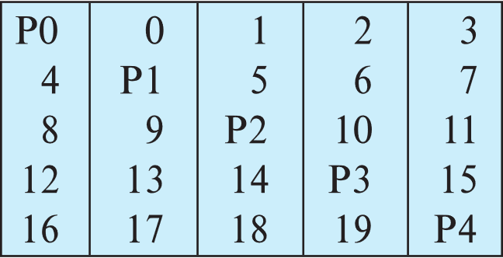
RAID Levels (Cont.)
RAID Level 5
  Block-Interleaved Distributed Parity(块交叉的分布奇偶校验); partitions data and parity among all N + 1 disks, rather than storing data in N disks and parity in 1 disk.
  E.g., with 5 disks, parity block for n-th set of blocks is stored on disk (n mod 5) + 1, with the data blocks stored on the other 4 disks.

Slide 35
RAID Levels (Cont.)
RAID Level 5 (Cont.)
  Higher I/O rates than Level 4.
    Block writes occur in parallel if the blocks and their parity blocks are on different disks.
  Subsumes Level 4: provides same benefits, but avoids bottleneck of parity disk.
RAID Level 6
  P+Q Redundancy scheme; similar to Level 5, but stores extra redundant information to guard against multiple disk failures.
  Better reliability than Level 5 at a higher cost; not used as widely.
Notes:
Subsumes :【逻辑学】包摄,包含

Slide 36
Choice of RAID Level
Factors in choosing RAID level
  Monetary cost
  Performance: Number of I/O operations per second, and bandwidth during normal operation
  Performance during failure
  Performance during rebuild of failed disk
    Including time taken to rebuild failed disk
RAID 0 is used only when data safety is not important
  E.g. data can be recovered quickly from other sources
Level 2 and 4 never used since they are subsumed by 3 and 5
Level 3 is not used anymore since bit-striping forces single block reads to access all disks, wasting disk arm movement, which block striping (level 5) avoids
Level 6 is rarely used since levels 1 and 5 offer adequate safety for almost all applications
So competition is between 1 and 5 only

Slide 37
Choice of RAID Level (Cont.)
Level 1 provides much better write performance than level 5
  Level 5 requires at least 2 block reads and 2 block writes to write a single block, whereas Level 1 only requires 2 block writes
  Level 1 preferred for high update environments such as log disks
Level 1 had higher storage cost than level 5
  disk drive capacities increasing rapidly (50%/year) whereas disk access times have decreased much less (x 3 in 10 years)
  I/O requirements have increased greatly, e.g. for Web servers
  When enough disks have been bought to satisfy required rate of I/O, they often have spare storage capacity
    so there is often no extra monetary cost for Level 1!
Level 5 is preferred for applications with low update rate, and large amounts of data
Level 1 is preferred for all other applications

Slide 38
Hardware Issues
Software RAID: RAID implementations done entirely in software, with no special hardware support
Hardware RAID: RAID implementations with special hardware
  Use non-volatile RAM to record writes that are being executed
  Beware: power failure during write can result in corrupted disk
    E.g., failure after writing one block but before writing the second in a mirrored system
    Such corrupted data must be detected when power is restored
      Recovery from corruption is similar to recovery from failed disk
      NV-RAM helps to efficiently detect potentially corrupted blocks
        Otherwise all blocks of disk must be read and compared with mirror/parity block

Slide 39
Hardware Issues (Cont.)
Hot swapping(热交换): replacement of disk while system is running, without power down
  Supported by some hardware RAID systems
  reduces time to recovery, and improves availability (可用性) greatly
Many systems maintain spare disks which are kept online, and used as replacements for failed disks immediately on detection of failure
  Reduces time to recovery greatly
Many hardware RAID systems ensure that a single point of failure will not stop the functioning of the system by using
  Redundant power supplies with battery backup
  Multiple controllers and multiple interconnections to guard against controller/interconnection failures

Slide 40
Outline
Overview of Physical Storage Media
Magnetic Disks
RAID
Tertiary Storage
Storage Access
File Organization
Organization of Records in Files
Data-Dictionary Storage

Slide 41
Optical Disks
Compact disk-read only memory (CD-ROM)
  Removable disks, 640 MB per disk
  Seek time about 100 msec (optical read head is heavier and slower)
  Higher latency (3000 RPM) and lower data-transfer rates (3-6 MB/s) compared to magnetic disks
Digital Video Disk (DVD)
  DVD-5 holds 4.7 GB , and DVD-9 holds 8.5 GB
  DVD-10 and DVD-18 are double sided formats with capacities of 9.4 GB and 17 GB
  Slow seek time, for same reasons as CD-ROM
Record once versions (CD-R and DVD-R) are popular
  Data can only be written once, and cannot be erased
  High capacity and long lifetime; used for archival storage
Multi-write versions (CD-RW, DVD-RW, DVD+RW and DVD-RAM) also available

Slide 42
Magnetic Tapes
Hold large volumes of data and provide high transfer rates
  Few GB for DAT (Digital Audio Tape) format
  10-40 GB with DLT (Digital Linear Tape) format
  100 GB+ with Ultrium format
  330 GB with Ampex helical scan format
  Transfer rates from few to 10s of MB/s
Currently the cheapest storage medium
  Tapes are cheap, but cost of drives is very high

Slide 43
Magnetic Tapes (Cont.)
Very slow access time in comparison to magnetic disks and optical disks
  Limited to sequential access.
  Some formats provide faster seek (10s of seconds) at cost of lower capacity
Used mainly for backup, for storage of infrequently used information, and as an off-line medium for transferring information from one system to another.
Tape jukeboxes(自动磁带机) used for very large capacity storage
  terabyte (10¹² bytes) to petabye (10¹⁵ bytes)

Slide 44
未来存储技术
分布式、云化、闪存化、智能等存储不断发展，随着人工智能、物联网、区块链、人体增强 (Human Augmentation) 等技术快速发展，存储也将迎来新的形态，如：
  边缘存储
  长期存储
  生物存储/基因存储
  区块链存储
  量子存储

Slide 45
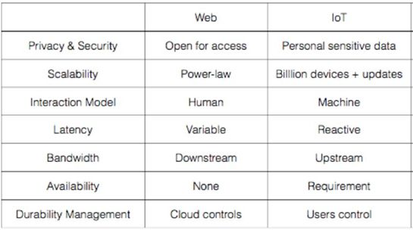
边缘存储
加州大学伯克利分校的研究团队在2015年发表 “The Cloud is Not Enough: Saving IoT from the Cloud“ 文章，指出物联网与互联网的七个不同之处：隐私和安全；可伸缩性；交互模型；延迟；带宽；可用性；持久性管理。边缘存储应该具有高可用性、超低延迟、高安全性、高隐私性、弱一致性、功耗低、空间小的特点，边缘存储仍处于发展早期，还有很多需研究探索
Notes:
互联网与物联网的七个不同之处
1 ）隐私和安全方面（Privacy&Security ）
互联网是开放访问的。
物联网里，植入到人们周边环境的传感器，其收集的通常是敏感信息。例如智能门锁、心脏起搏器等，这类信息的泄密将直接关系到人的生命财产安全。
2 ）可伸缩性（Scalability ）
物联网中的可伸缩性比互联网更具挑战，生成的数据量将达数万亿个对象。物联网设备所需的大多数数据应该在本地处理，并可能立即丢弃，因此只有集中式的云是不够的。
3 ）交互模型（InteractionModel ）
互联网是人机交互的。
而物联网是机器与机器交互；需要注意的是，有些交互必须伴随着交易，或者说是价值的转移，否则这些交互是不会发生的。
4 ）延迟（Latency ）
场景不同，互联网对延迟的要求不同。
但物联网要求实时响应。例如，为响应本地温度的升高而打开风扇的应用程序，如果只有集中式的云，那这一简单的操作，也将经历来自感知、无线传输、网关处理、互联网访问和云处理的不可预测的延迟。
其实集中式的云，相对传感器，就是距离较远的“边缘”
备注：虽然应用程序通常将云视为所有连接设备的中心( 上半图) ，但实际上云通常位于互联网主干的边缘，就像其他设备( 下半图) 一样。
5 ）带宽（Bandwidth ）
互联网主要产生的是下行流量。
物联网中，将数据传送到云端会产生大量的上行流量。物联网应用程序在网络边缘生成数据，这种模式很容易使上行链路的带宽饱和。使用边缘计算后，能让数据就地处理，也能减少不必要的带宽浪费。
6 ）可用性（Availability ）
互联网用户可以容忍某些场景的可变延迟，容忍偶尔丢失Web 服务。相比之下，物联网应用中传感器或执行器（actuators ）的临时失效将严重影响到物理世界。
物联网中，有不少场景对于可用性有着近乎苛刻的要求。例如，对周边道路环境的感知和处理，是不可能仅仅依赖于集中式的云。
7 ）持久性管理（DurabilityManagement ）
持久性管理。一些传感器数据是短暂的，而另一些数据应该是持久的，以抵御灾难。现在没有有效的方法来验证数据是否已经被完全销毁，因为云已经超出了用户的控制范围，无论云实现了什么持久性，通常都是在不考虑特定应用程序的隐私的。对持久性的控制一般与控制密切相关：应该确保用户重新控制和拥有他们的数据，而不是提供者。
综上所述，我们认为，有别于云存储，边缘存储应该具有高可用性、超低延迟、高安全性、高隐私性、弱一致性、功耗低、空间小的特点

Slide 46
长期存储 - Long Data
蓝光光盘
  2019中国数据与存储峰会，“Long Data ”挑战国际上研究课题How to preserve information for 100 years？基于蓝光技术可提供解决办法，蓝光光盘具超过50年寿命，极低功耗，高安全性，较高密度，较低成本，对环境要求低。总体而言，光存储技术尤其适合大量冷数据的长期安全存储。
  针对于需要保存长达数十年的行业或场景，基于蓝光光盘的存储技术是一个选择，如电子档案、医疗影像、金融影像、备份归档等。一个标准机柜可保存1.22 万片光盘，如果采用500GB 光盘，裸容量可高达6PB 。市场上一种M-Disc 的产品，号称千年光盘
玻璃光盘
  正在研究的玻璃光盘容量是蓝光光盘的几千倍，能承受超过几百度的高温，寿命能高达上万年甚至百亿年。如微软的玻璃光盘项目ProjectSilica
全息光存储
  蓝光之后下一代变革性光存储技术包括两种：第一种是同轴多维全息光存储技术，列入国家重点研发计划。第二种是2014年得了诺贝尔奖的突破光的衍射极限项目，澳大利亚科学家把这个技术用到光上，把光斑从300纳米理论上可以减少到九个纳米，容量上得到巨大提高，至少可达每盘15TB，理想上可实现PB级。

Slide 47
生物存储或基因存储
生物存储或基因存储
  人类历史上，已经有过历经千百年的存储介质，如青铜器铭文、竹简、纸书、石碑等。不过，这类手段存储密度极低。《自私的基因》一书观点：包括人在内的动植物不过是DNA 繁衍的躯壳，你也可以看成是DNA 的存储器。
  可以反向让DNA 片段，即基因成为人类存放信息的存储器。基因存储将0 、1 数据通过一定的编码方法转换成DNA 中的A 、T 、C 、G 四种碱基，通过合成含有这些碱基序列的DNA 即可实现数据信息存储。

Slide 48
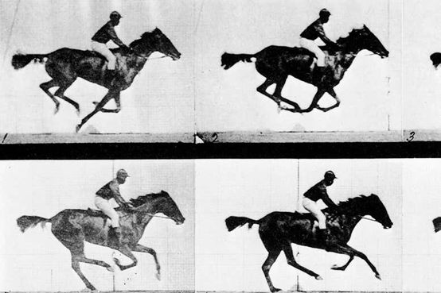
生物存储或基因存储
生物存储或基因存储
  2017年7月，哈佛大学医学院利用CRISPR DNA编辑技术，将赛马视频录入大肠杆菌的基因组中，并以超过90%的准确率读取出来。
  2019年7月，美国布朗大学研究人员用基于生物小分子的存储系统累计存储了超过10万比特的数字图像信息，从中获得图像的准确率可达98% 以上。
  2020年2月，华尔街日报报道，波士顿初创公司Catalog Technologies 正在开发一种独特的方式来存储大量数据，将维基百科中14GB 数据存储在DNA 分子中，像“在试管中滴几滴水”。用分子生物学仪器“打印”合成分子序列，以DNA形式存储和表示数字信息，使用DNA测序仪和专有软件的来读取信息，软件可以将分子翻译成文本、图片甚至视频。

Slide 49
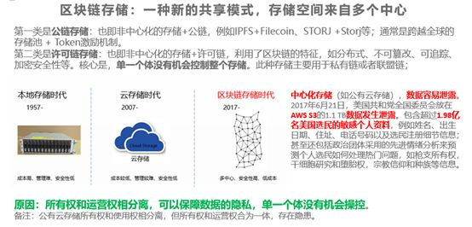
区块链存储
如何在激励数据提供方分享数据的同时，又能保护隐私？区块链和存储的结合
  区块链解决了数据确权、激励分享、数据资产交易和流转等问题。但区块链要发展，区块链基础设施要先行，目前区块链基础设施还处于非常早期，使得区块链应用数据的存储，具有很大的问题。无论是公有链还是联盟链，数据都是存放在中心化的存储上，前者可能选择公有云存储，后者选择类似NAS存储，都存在安全隐患、隐私泄露的可能性。实际上，去中心化的应用DApp （Distributed App）需要的是端到端的去中心化的基础设施，包括去中心化方式组织的存储。

Slide 50
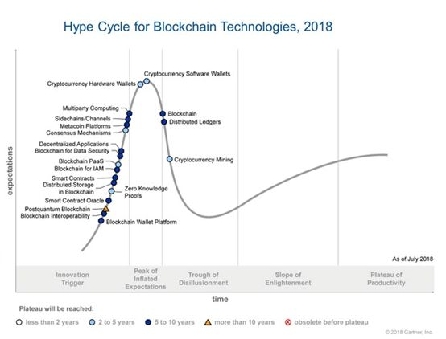
区块链存储
区块链和存储的结合
  2018年7月，Gartner技术成熟度曲线中区块链存储(Distributed Storage in Blockchain) 列入科技诞生促动期(Technology Trigger) ，预计2023~2028年进入到成熟应用的技术阶段，将有大量主流用户开始接纳

Slide 51
Outline
Overview of Physical Storage Media
Magnetic Disks
RAID
Tertiary Storage
Storage Access
File Organization
Organization of Records in Files
Data-Dictionary Storage

Slide 52
Storage Access
Storage of database file
  partitioned into fixed-length storage units called blocks. Blocks are units of both storage allocation and data transfer
  Database system seeks to minimize the number of block transfers between the disk and memory. We can reduce the number of disk accesses by keeping as many blocks as possible in main memory
Buffer
  The portion of main memory available to store copies of disk blocks
  Buffer manager: subsystem responsible for allocating buffer space in main memory
Notes:
最近最少使用

Slide 53
Buffer Manager
Programs call the buffer manager when they need a block from disk
  If the block is already in the buffer, buffer manager returns the address of the block in main memory
  If the block is not in the buffer, the buffer manager
    allocates space in the buffer for the block
      Replacing (throwing out) some other block, if required, to make space for the new block.
      Replaced block is written back to disk only if it was modified since the most recent time that it was written to/fetched from the disk
    reads the block from the disk to the buffer, and returns the address of the block in main memory to requester

Slide 54
Buffer-Replacement Policies
LRU (Lest Recently Used，最近最少使用)
  Most operating systems replace the block least recently used
  Idea behind LRU – use past patterns of block references as a predictor of future references
  LRU can be a bad strategy for certain access patterns involving repeated scans of data
    E.g., computing the join of two relations r and s by a nested loops
    for each tuple t_{r} of r do
    for each tuple t_{s} of s do
    if the tuples t_{r} and t_{s} match
    …

Slide 55
Buffer-Replacement Policies (Cont.)
Pinned block(被钉住的块)
  memory block that is not allowed to be written back to disk
Toss-immediate (立即丢弃) strategy
  free the space occupied by a block as soon as the final tuple of that block has been processed
Most recently used (MRU) (最近最常使用) strategy
  system must pin the block currently being processed. After the final tuple of that block has been processed, the block is unpinned, and it becomes the most recently used block

Slide 56
Outline
Overview of Physical Storage Media
Magnetic Disks
RAID
Tertiary Storage
Storage Access
File Organization
Organization of Records in Files
Data-Dictionary Storage

Slide 57
File Organization
The database is stored as a collection of files. Each file is a sequence of records. A record is a sequence of fields
One approach
  Assume that the record size is fixed
  Each file has records of one particular type only
  Different files are used for different relations
  Note: this case is easy to implement. We will consider variable length records later

Slide 58
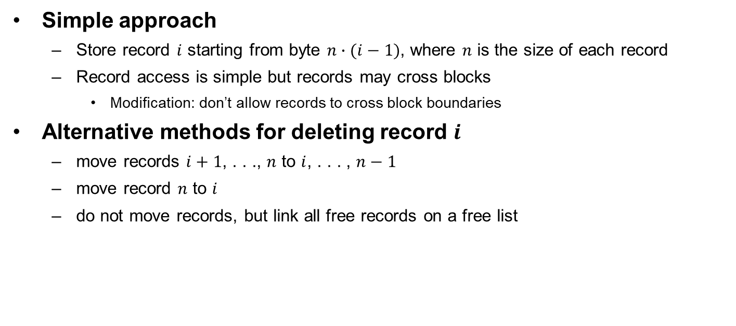
Fixed-Length Records
Simple approach
  Store record $i$ starting from byte $n∙(i−1)$, where $n$ is the size of each record
  Record access is simple but records may cross blocks
    Modification: don’t allow records to cross block boundaries
Alternative methods for deleting record $i$
  move records $i+1$, . . ., $n$ to $i$, . . . , $n−1$
  move record $n$ to $i$
  do not move records, but link all free records on a free list

Slide 59
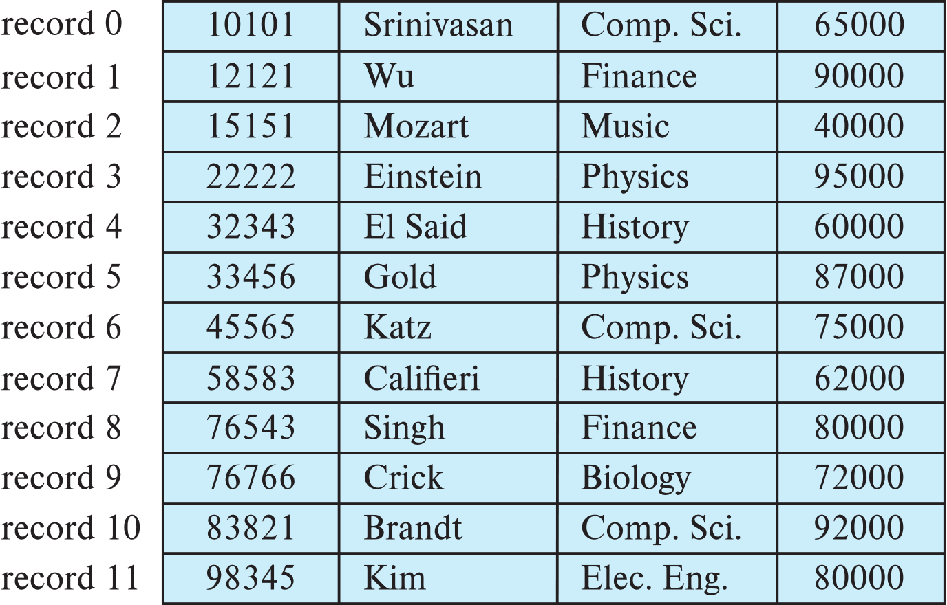
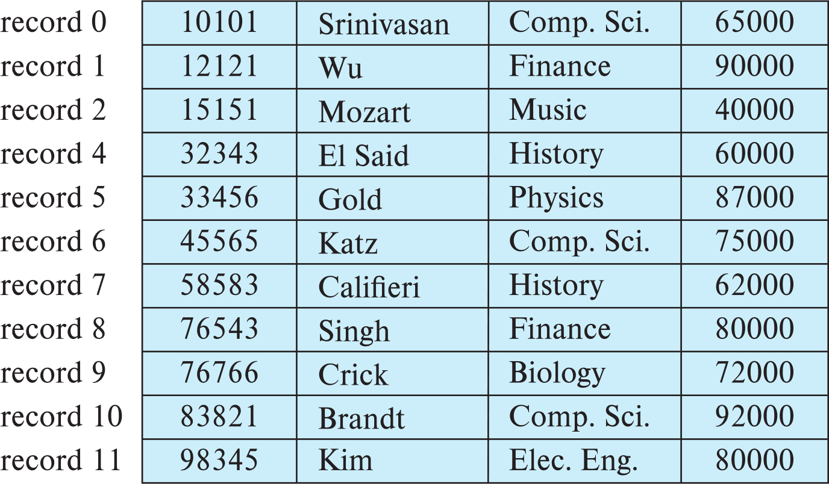
Delete Record 3 and Move All Records

Slide 60
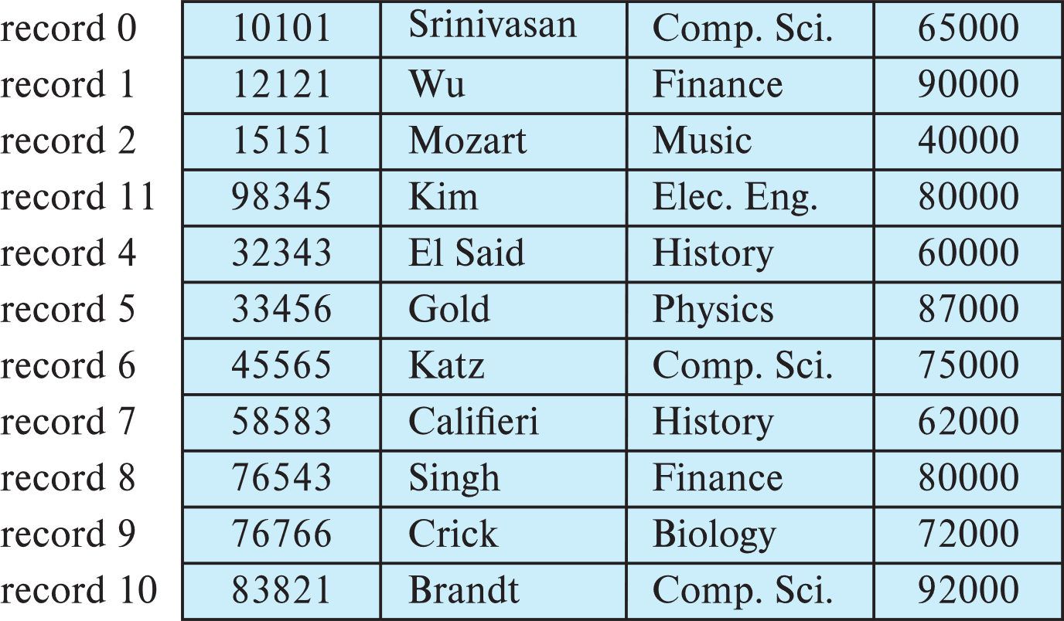
Delete Record 3 and Move Final Record

Slide 61
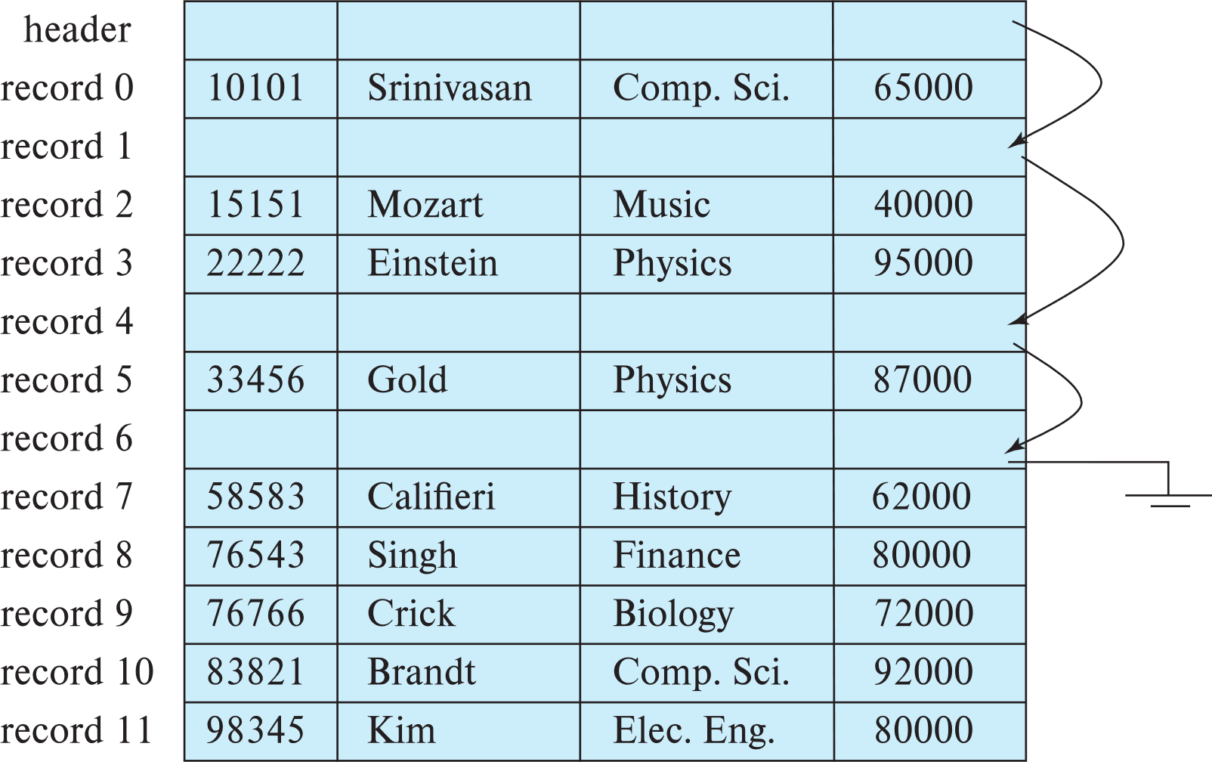
Free List (空闲列表)
Store the address of the first deleted record in the file header
Use the first record to store the address of the second deleted record, and so on
These stored addresses are pointers since they “point” to the location of a record

Slide 62
Variable-Length Records (变长记录)
Variable-length records
  Storage of multiple record types in a file
  Record types that allow variable lengths for one or more fields
  Record types that allow repeating fields, e.g., array and multiset (used in some old data models)

Slide 63
Variable-Length Records: Slotted Page Structure
Slotted page (分槽的页) header contains
  number of record entries
  end of free space in the block
  location and size of each record
Records can be moved around within a page to keep them contiguous with no empty space between them; entry in the header must be updated
Pointers should not point directly to record — instead they should point to the entry for the record in header
Notes:
间接指针在块自身移动记录（防止在块的内部出现碎片空间）后无需更新

Slide 64
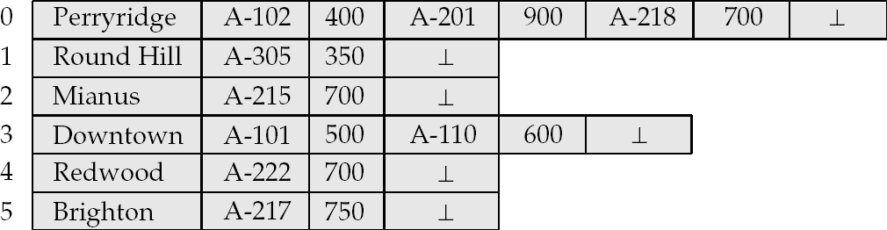
Byte String Representation of Variable-Length Records
Byte string representation
  Attach an end-of-record (⊥) control character to the end of each record
  Difficulty with deletion
  Difficulty with growth

Slide 65
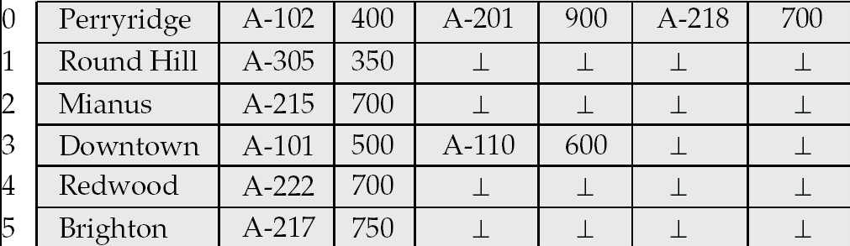
Fixed-Length Representation
Use one or more fixed length records
  reserved space
  pointers
Reserved space – can use fixed-length records of a known maximum length; unused space in shorter records filled with a null or end-of-record symbol.
Notes:
Reserved space ：保留空间

Slide 66
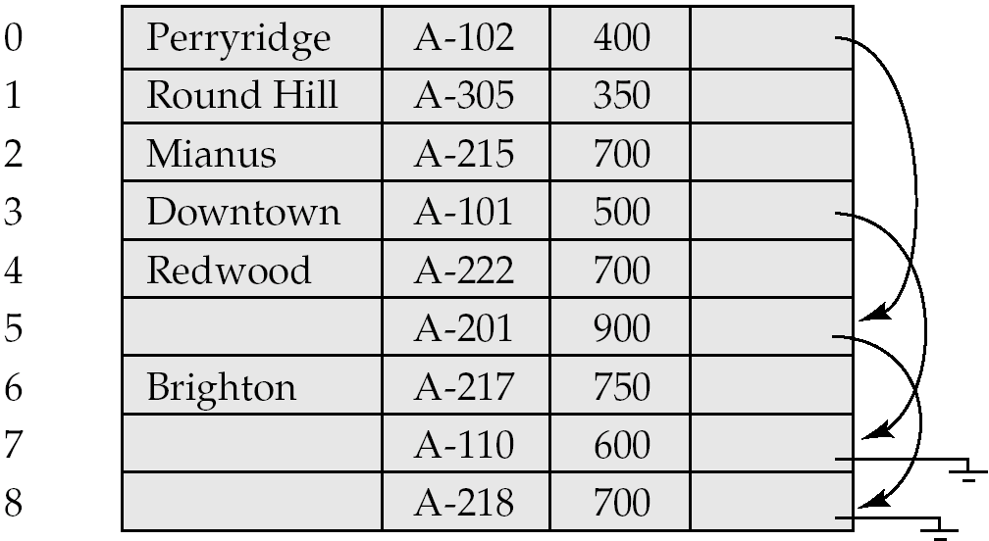
Pointer Method
Pointer method
  A variable-length record is represented by a list of fixed-length records, chained together via pointers
  Can be used even if the maximum record length is not known

Slide 67
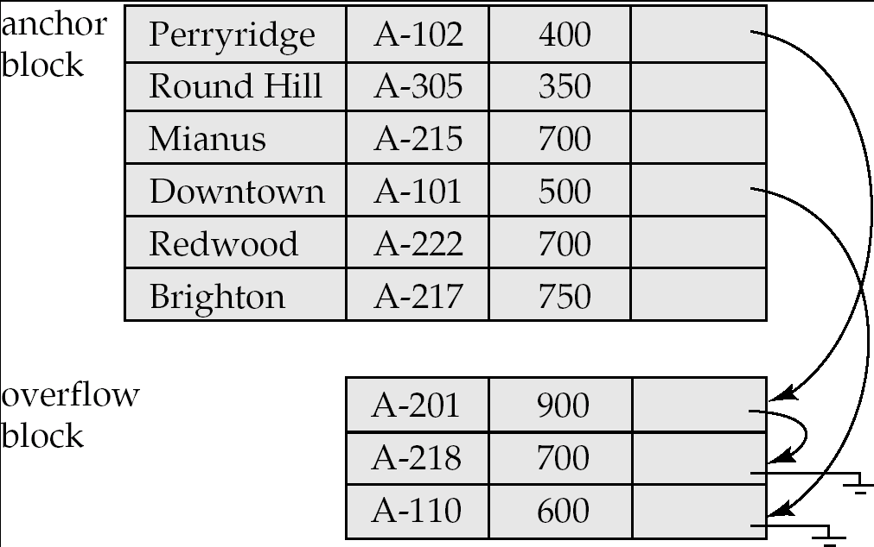
Pointer Method (Cont.)
Disadvantage to pointer structure; space is wasted in all records except the first in a chain
Solution is to allow two kinds of block in file:
  Anchor block – contains the first records of chain
  Overflow block – contains records other than those that are the first records of chains
Notes:
Anchor block ：锚块

Slide 68
Outline
Overview of Physical Storage Media
Magnetic Disks
RAID
Tertiary Storage
Storage Access
File Organization
Organization of Records in Files
Data-Dictionary Storage

Slide 69
Organization of Records in Files
Sequential (顺序)
  store records in sequential order, based on the value of the search key of each record
Heap (堆)
  a record can be placed anywhere in the file where there is space
Hashing (散列)
  a hash function computed on some attribute of each record; the result specifies in which block of the file the record should be placed

Slide 70
Sequential File Organization
Suitable for applications that require sequential processing of the entire file
The records in the file are ordered by a search-key

Slide 71
Sequential File Organization (Cont.)
Deletion – use pointer chains
Insertion –locate the position where the record is to be inserted
  if there is free space insert there
  if no free space, insert the record in an overflow block
  In either case, pointer chain must be updated
Need to reorganize the file
from time to time to restore
sequential order

Slide 72
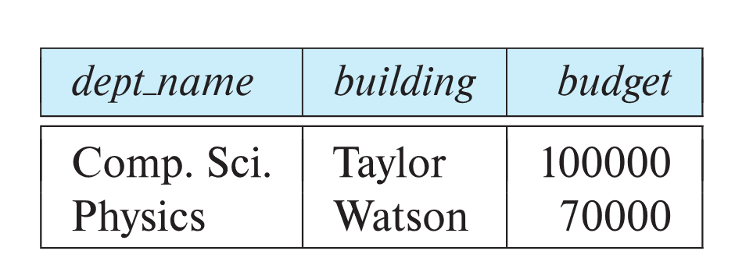
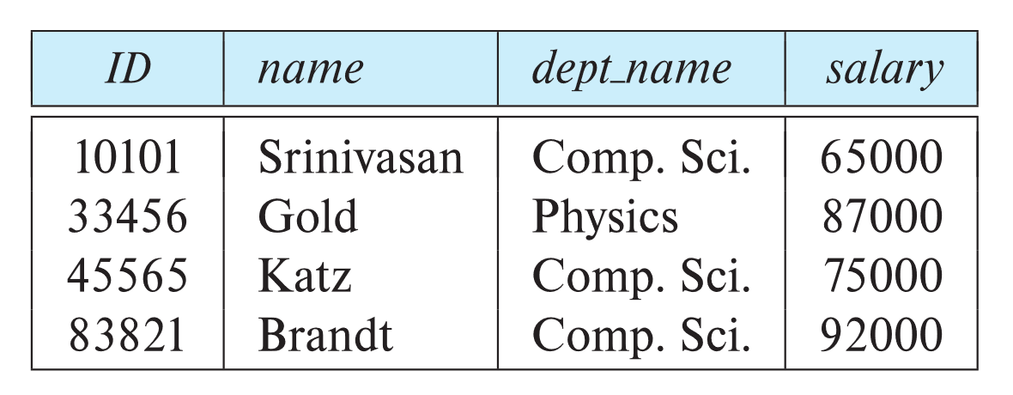
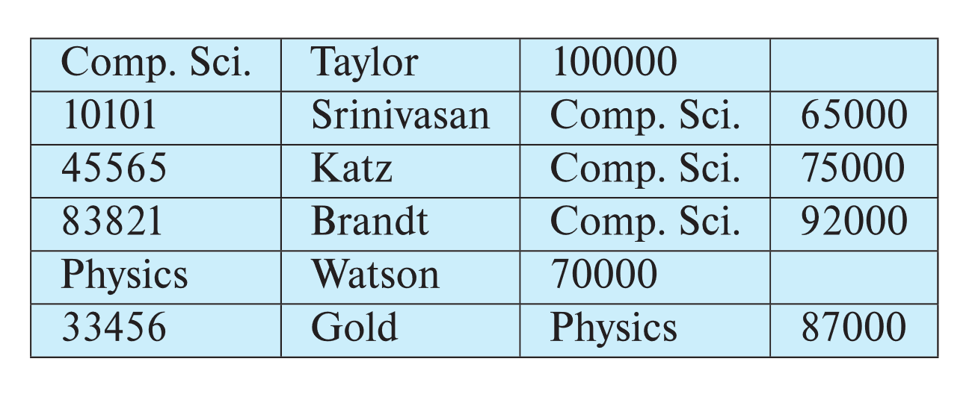
Multi-table Clustering File Organization
Store several relations in one file using a multi-table clustering file organization
department
instructor
Multi-table clustering
of department and
instructor
Notes:
多表集群文件组织

Slide 73
Multi-table Clustering File Organization (Cont.)
good for queries involving department ⨝ instructor, and for queries involving one single department and its instructors
bad for queries involving only department
results in variable size records
Can add pointer chains to link records of a particular relation

Slide 74
Outline
Overview of Physical Storage Media
Magnetic Disks
RAID
Tertiary Storage
Storage Access
File Organization
Organization of Records in Files
Data-Dictionary Storage

Slide 75
Data Dictionary Storage
Data dictionary (also called system catalog) stores metadata, i.e., data about data, such as
Information about relations
  names of relations
  names and types of attributes of each relation
  names and definitions of views
  integrity constraints
User and accounting information, including passwords
  Statistical and descriptive data
  the number of tuples in each relation
Physical file organization information
  How relation is stored (sequential/hash/…)
  Physical location of relation
Information about indices (Chapter 14)

Slide 76
Data Dictionary Storage (Cont.)
Catalog structure
  relational representation on disk
  specialized data structures designed for efficient access
A possible catalog representation:
relation_metadata = (relation_name, number_of_attributes, storage_organization, location)
attribute_metadata = (attribute_name, relation_name, domain_type, position, length)
user_metadata = (user_name, encrypted_password, group)
index_metadata = (index_name, relation_name, index_type, index_attributes)
view_metadata = (view_name, definition)

Slide 77
数据库及存储技术（补充）

Slide 78
内存数据库
内存数据库
  将数据放在内存中直接操作的数据库。相对于磁盘，内存的数据读写速度要高出几个数量级，将数据保存在内存中相比从磁盘上访问能够极大地提高应用的性能同时，内存数据库抛弃了磁盘数据管理的传统方式，基于全部数据都在内存中重新设计了体系结构，并且在数据缓存、快速算法、并行操作方面也进行了相应的改进，所以数据处理速度比传统数据库的数据处理速度要快很多，一般都在10倍以上。内存数据库的最大特点是其“主拷贝”或“工作版本”常驻内存，即活动事务只与实时内存数据库的内存拷贝打交道。
定义
  设有数据库系统DBS，DB为DBS中的数据库，DBM(t)为在时刻t，DB在内存的数据集，DBM(t)属于DB。TS为DBS中所有可能的事务构成的集合。AT(t)为在时刻t处于活动状态的事务集，AT(t)属于TS。Dt(T)为事务T在时刻t所操作的数据集，
  Dt(T)属于DB。若在任意时刻t，均有: 任意T属于AT(t) Dt(T)属于DBM(t)成立，则称DBS为一个内存数据库系统，简称MMDBS;DB为一个内存数据库，简称MMDB
  常见的例子有MySQL的MEMORY存储引擎、eXtremeDB、TT、FastDB、SQLite、Microsoft SQL Server Compact等

Slide 79
内存数据库与传统数据库
传统的数据库系统是关系型数据库，开发这种数据库的目的，是处理永久、稳定的数据。关系数据库强调维护数据的完整性、一致性，但很难顾及有关数据及其处理的定时限制，不能满足工业生产管理实时应用的需要，因为实时事务要求系统能较准确地预报事务的运行时间。对磁盘数据库而言，由于磁盘存取、内外存的数据传递、缓冲区管理、排队等待及锁的延迟等使得事务实际平均执行时间与估算的最好情况执行时间相差很大，如果将整个数据库或其主要的“工作”部分放入内存，使每个事务在执行过程中没有I/O，则为系统较准确估算和安排事务的运行时间，使之具有较好的动态可预报性提供了有力的支持，同时也为实现事务的定时限制打下了基础。这就是内存数据库出现的主要原因。
内存数据库所处理的数据通常是“短暂”的，即有一定的有效时间，过时则有新的数据产生，而当前的决策推导变成无效。所以，实际应用中采用内存数据库来处理实时性强的业务逻辑处理数据。而传统数据库旨在处理永久、稳定的数据，其性能目标是高的系统吞吐量和低的代价，处理数据的实时性就要考虑得相对少一些。实际应用中利用传统数据库这一特性存放相对实时性要求不高的数据。
在实际应用中这两种数据库常常结合使用，而不是以内存数据库替代传统数据库。

Slide 80
闪存数据库
闪存（Flash Memory）是一种长寿命的非易失性（在断电情况下仍能保持所存储的数据信息）的存储器，数据删除不是以单个的字节为单位而是以固定的区块为单位，区块大小一般为256KB到20MB。闪存是电子可擦除只读存储器（EEPROM）的变种，EEPROM与闪存不同的是，它能在字节水平上进行删除和重写而不是整个芯片擦写，这样闪存就比EEPROM的更新速度快。由于其断电时仍能保存数据，闪存通常被用来保存设置信息，如在电脑的BIOS（基本输入输出程序）、PDA（个人数字助理）、数码相机中保存资料等。另一方面，闪存不像RAM（随机存取存储器）一样以字节为单位改写数据，因此不能取代RAM。
闪存卡（Flash Card）是利用闪存（Flash Memory）技术达到存储电子信息的存储器，一般应用在数码相机，掌上电脑，MP3等小型数码产品中作为存储介质，所以样子小巧，有如一张卡片，所以称之为闪存卡。根据不同的生产厂商和不同的应用，闪存卡大概有SmartMedia（SM卡）、Compact Flash（CF卡）、MultiMediaCard（MMC卡）、Secure Digital（SD卡）、Memory Stick（记忆棒）、XD-Picture Card（XD卡）和微硬盘（MICRODRIVE）这些闪存卡虽然外观、规格不同，但是技术原理都是相同的。

Slide 81
大数据及云存储

Slide 82
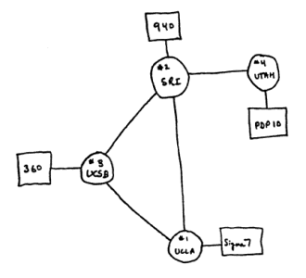
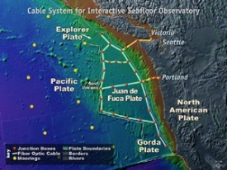

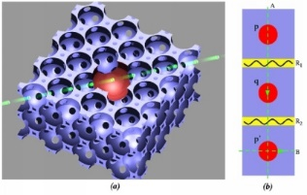


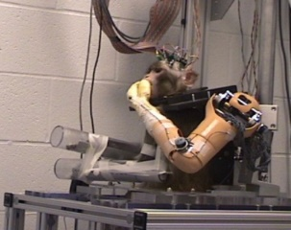




The Future is Full of Opportunity
Designing a next Internet – GENI
  Driving advances in all fields of science and engineering
Wreckless driving
Personalized education
Predictive, preventive, personalized medicine
Quantum computing (量子计算)
Personalized health monitoring => quality of life
Data-intensive supercomputing
Neurobotics (神经学机器人)
Synthetic biology (合成生物学)
The algorithmic lens => Cyber-enabled Discovery and Innovation

Slide 83
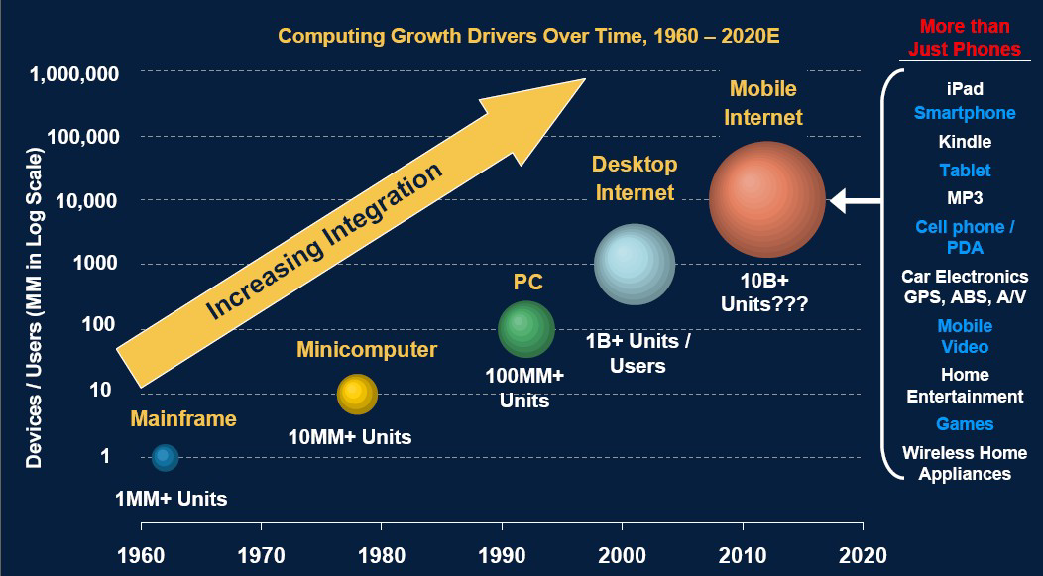
大数据时代的背景
Morgan Stanley, Internet Trends, June 7, 2010
Notes:
未来的十年将是一个“大数据”引领的智慧科技时代。随着社交网络的逐渐成熟，移动带宽迅速提升，云计算、物联网应用更加丰富。更多的传感设备、移动终端接入到网络由此产生的数据及增长速度将比历史上的任何时期都要多，都要快。根据摩根斯坦利互联网研究2010年度报告，60年代，大型机接入网络的规模1MM左右，此后以每年增加1倍的速率增长，在2010，接入互联网的各种设备终端远超10B，与之相对应的是数据量倍增，国际数据公司（IDC）的研究结果表明，2008年全球产生的数据量为0.49ZB，2009年的数据量为0.8ZB，2010年增长为1.2ZB，2011年的数量更是高达1.82ZB，相当于全球每人产生200GB以上的数据。而到2012年为止，人类生产的所有印刷材料的数据量是200PB，全人类历史上说过的所有话的数据量大约是5EB。IBM的研究称，整个人类文明所获得的全部数据中，有90%是过去两年内产生的。而到了2020年，全世界所产生的数据规模将达到今天的44倍

Slide 84

大数据时代的背景
美国国家战略：大数据，大事业!
Notes:
现世的信息世界，是一个概念术语频繁更新的年代。业界关于云计算、物联网的声音刚刚落地，“大数据”时代的脚步悄然而至。2012年3月29日，美国奥巴马政府公布了“大数据研究与发展规划”，数据为王，它标志着强调数据本身价值的的大数据时代的来临

Slide 85




大数据的困难
容量大
美国国会图书馆存档信息量：约 80TB
Kilo
Mega
Giga
Tera
Peta
Exa
Zeta
Yotta
科学计算
新墨西哥州的天文望远镜每年产生80TB的图像信息
生物信息
第一个中国人的全基因组图谱，1177亿碱基对
电子商务
每月交易21亿笔，产生300TB交易日志信息
网络生活
7亿用户、400亿张照片，总容量超过1500TB

Slide 86
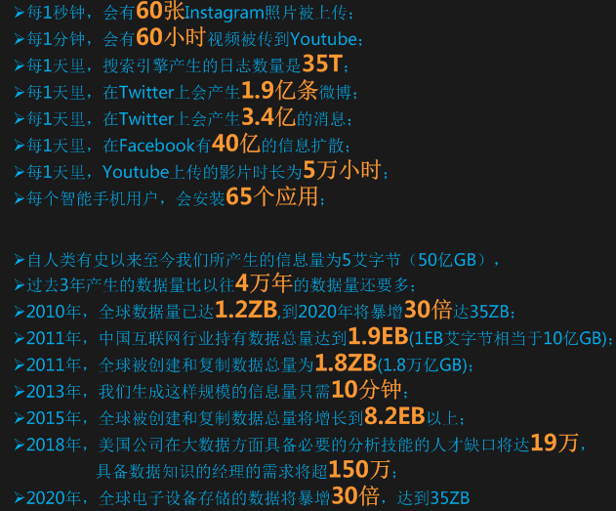
大数据的困难
容量大
Kilo
Mega
Giga
Tera
Peta
Exa
Zeta
Yotta

Slide 87
大数据的困难
非结构化
  非结构化=没有找到
  共性特征：没有
  多层结构

Slide 88
大数据的困难
仅有MapReduce
MapReduce=Big Data？
MapReduce不是万能的
MapReduce只顾埋头干活、从不抬头看路
MapReduce不是万能的

Slide 89

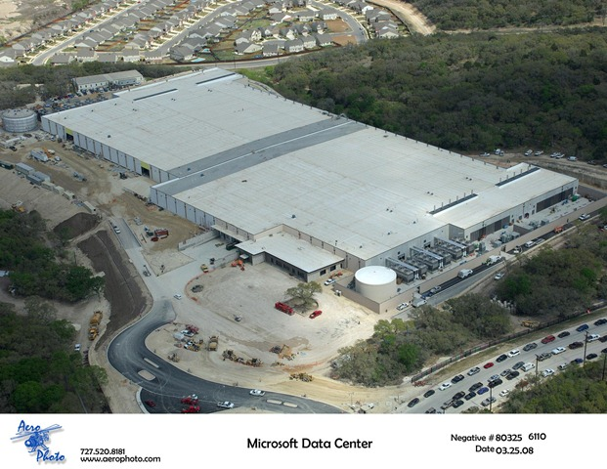
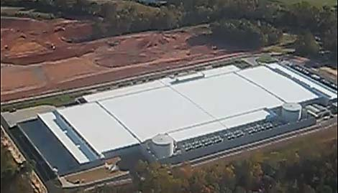
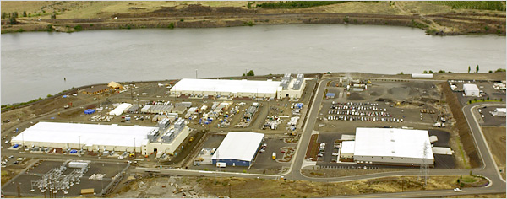
大数据的困难
数据中心—看上去，规模庞大
微软(Microsoft)数据中心
脸谱(Facebook) 数据中心
苹果(Apple) 数据中心
谷歌(Google) 数据中心
Notes:
那我们先看一下数据中心有多大，现有数据中心通常有几十万个节点，占地面积要超过一个万人体育馆。未来大型数据中心要有百万个节点

Slide 90


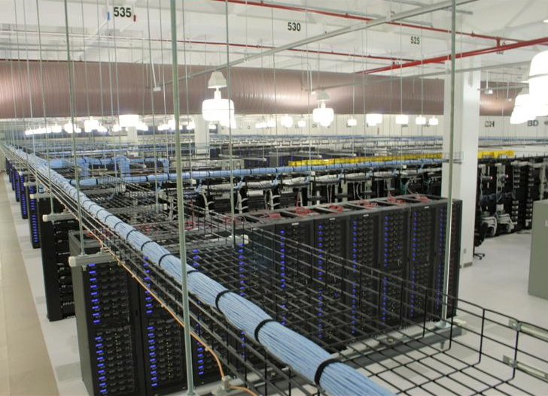
大数据的困难
数据中心—走进去，结构复杂

Slide 91
新技术
针对存储
  石英玻璃数据存储技术：可保存数据数亿年，电脑硬盘驱动器的数据保存时间就只有10年，使用较频繁的闪存盘数据保存时间至多5年，而磁带的数据保存时限则达15至30年。
  双写入存储技术：提升至10TB/平方英寸，目前硬盘中所使用的垂直记录技术的存储密度极限大约是每平方英寸数百GB。 两种新写入方式名为“热辅助磁记录技术”(Thermally-Assisted Magnetic Recording：TAR）,和 “位式记录技术”（bit-patterned recording：BPR）

Slide 92
新技术
针对传输
  量子网络瞬间通信不延迟: 一个粒子可以传递有限的信息，而亿万个粒子联手就形成了量子网络，而这种信息传递没有任何的延迟。通过量子网络相互连接的量子计算机和量子服务器将应用量子纠缠实现无缝通讯
  光纤：一根光纤可供2.1亿对人同时通话，一根普通单模光纤中C波段168路，每路103Gb/s的超大容量超密集波分复用传输2240公里，传输总容量达到17.32Tb/s，相当于2.1亿对人在一根光纤上同时通话
  HMC技术：传输率可达1TB/s，Hybrid Memory Cube技术相比于当今主流的DDR3在能源效率上有至少7倍以上的优势。Hybrid Memory Cube技术使用堆叠技术将内存芯片压缩成一个紧凑的“立方体”，并配有新的高速传输接口。新的数据传输接口传输率可达到1TB/s。

Slide 93
新技术
针对Hadoop
  交互式数据分析系统Dremel
    可以在几秒钟内处理PB级别的数据，并能轻松应对即时查询
  谷歌的图数据计算框架Pregel，微软的Trinity
    针对大规模图算法（如图遍历（BFS）、PageRank，最短路径（SSSP）等）。处理一个有着几十亿节点、上万亿条边的图，只需数分钟即可完成，其执行时间随着图的大小呈线性增长。

Slide 94
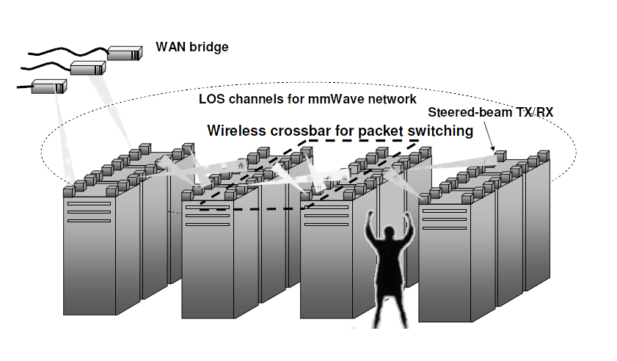
新技术
针对数据中心

Slide 95
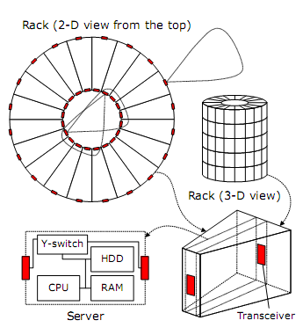
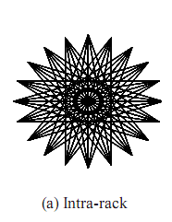
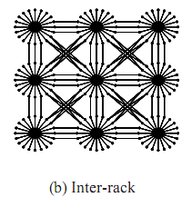
新技术
针对数据中心
  扇形机架 + 柱形机箱
  机箱内: 冗余链接、强连通
  机箱间: 2维类Mesh拓扑

Slide 96

新技术
针对数据中心
  微型数据中心
  台式数据中心

Slide 97
云存储（cloud storage）
云存储是云计算的存储部分，即虚拟化的、易于扩展的存储资源池。用户通过云计算使用存储资源池，但不是所有的云计算的存储部分都是可以分离的。
云存储意味着存储可以作为一种服务，通过网络提供给用户。用户可通过若干种方式使用存储，按使用（时间、空间或两者结合）付费：
  通过互联网开放接口（如REST），使得第三方网站可以通过云存储提供的服务为用户提供完整的Web服务；
  用户直接使用存储相关的在线服务，比如网络硬盘，在线存储，在线备份，或在线归档等服务；
  用户传送文件、或者服务商发布内容时的缓冲

Slide 98
云存储（cloud storage）
云存储在云计算 (cloud computing)概念上延伸和发展出来的概念
  云计算是分布式处理(Distributed Computing)、并行处理(Parallel Computing)和网格计算(Grid Computing)的发展，是透过网络将庞大的计算处理程序自动分拆成无数个较小的子程序，再交由多部服务器所组成的庞大系统经计算分析之后将处理结果回传给用户。通过云计算技术，网络服务提供者可以在数秒之内，处理数以千万计甚至亿计的信息，达到和”超级计算机”同样强大的网络服务
  云存储的概念与云计算类似，它是指通过集群应用、网格技术或分布式文件系统等功能，将网络中大量各种不同类型的存储设备通过应用软件集合起来协同工作，共同对外提供数据存储和业务访问功能的一个系统
  云存储对使用者来讲，不是指某一个具体设备，而是指一个由许许多多个存储设备和服务器所构成的集合体。使用者使用云存储，并不是使用某一个存储设备，而是使用整个云存储系统带来的一种数据访问服务。所以严格来讲，云存储不是存储，而是一种服务！

Slide 99
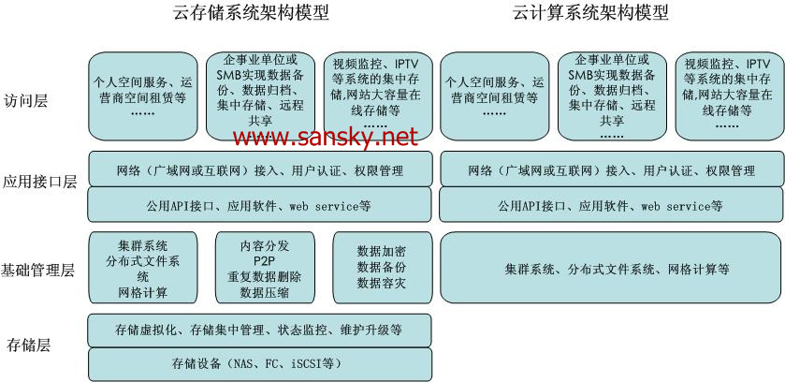
云存储（cloud storage）

Slide 100
云存储（cloud storage）
与传统存储设备相比，云存储不仅仅是一个硬件，而是一个网络设备、存储设备、服务器、应用软件、公用访问接口、接入网、和客户端程序等多个部分组成的复杂系统。各部分以存储设备为核心，通过应用软件来对外提供数据存储和业务访问服务
云存储系统的结构模型由 4层组成
  存储层是云存储最基础的部分
  基础管理层是云存储最核心部分，也是最难实现的部分
  应用接口层是云存储最灵活多变的部分
  访问层

Slide 101
云存储（cloud storage）
云存储系统的结构模型由 4层组成：存储层、基础管理层、应用接口层、访问层
存储层
  存储层是云存储最基础的部分。存储设备可以是FC光纤通道存储设备，可以是NAS和 iSCSI等IP存储设备，也可以是 SCSI或SAS等 DAS存储设备。云存储中的存储设备往往数量庞大且分布多不同地域，彼此之间通过广域网、互联网或者 FC光纤通道网络连接在一起
  存储设备之上是一个统一存储设备管理系统，可以实现存储设备的逻辑虚拟化管理、多链路冗余管理，以及硬件设备的状态监控和故障维护
基础管理层
  基础管理层是云存储最核心的部分，也是云存储中最难以实现的部分。基础管理层通过集群、分布式文件系统和网格计算等技术，实现云存储中多个存储设备之间的协同工作，使多个的存储设备可以对外提供同一种服务，并提供更大更强更好的数据访问性能
  CDN内容分发系统、数据加密技术保证云存储中的数据不会被未授权的用户所访问，同时，通过各种数据备份和容灾技术和措施可以保证云存储中的数据不会丢失，保证云存储自身的安全和稳定

Slide 102
云存储（cloud storage）
应用接口层
  应用接口层是云存储最灵活多变的部分。不同的云存储运营单位可根据实际业务类型，开发不同的应用服务接口，提供不同的应用服务。比如视频监控应用平台、IPTV和视频点播应用平台、网络硬盘应用平台，远程数据备份应用平台等
访问层
  任何一个授权用户都可以通过标准的公用应用接口来登录云存储系统，享受云存储服务。云存储运营单位不同，云存储提供的访问类型和访问手段也不同

Slide 103
云存储（cloud storage）
云存储系统是多设备、多应用、多服务协同工作集合体，其技术前提：
  云存储系统是多设备、多应用、多服务协同工作的集合体
  WEB2.0技术
  应用存储的发展
  集群技术、网格技术和分布式文件系统
  CDN内容分发、P2P技术、数据压缩技术、重复数据删除技术、数据加密技术
  存储虚拟化技术、存储网络化管理技术

Slide 104
云存储（cloud storage）
云存储（cloud storage）得到众多厂商的支持和关注
  Amazon推出的Elastic Compute Cloud（EC2：弹性计算云）云存储产品，旨在为用户提供互联网服务形式同时提供更强的存储和计算功能
  内容分发网络服务提供商CDNetworks和业界著名的云存储平台服务商 Nirvanix发布了一项合作，并宣布结成战略伙伴关系，以提供业界的云存储和内容传送服务集成平台
  微软推出提供网络移动硬盘服务的Windows Live SkyDrive
  EMC加入道里可信基础架构项目，致力于云计算环境下关于信任和可靠度保证的全球研究协作
  IBM将云计算标准作为全球备份中心的3亿美元扩展方案的一部分

Slide 105
End of Chapters 12 & 13

